Slide 1


ADRIJE GUHA
July 24, 2023

Slide 2

Table Of Contents
Executive Summary
Introduction
Methodology
Results
Conclusion
Appendix

Slide 3
Executive Summary
SpaceY is a new commercial rocket launch provider who wants to bid against SpaceX.
SpaceX advertises launch services starting at $62 million for missions that allow some fuel to be reserved for landing the 1st stage rocket booster, so that it can be reused.
SpaceX public statements indicate a 1st stage Falcon 9 booster to cost upwards of $15 million to build without including R&D cost recoupment or profit margin.
Given mission parameters such as payload mass and desired orbit, the models produced in this report were able to predict the first stage rocket booster landing successfully with an accuracy level of 83.3%.
As a result, SpaceY will be able to make more informed bids against SpaceX by using 1st stage landing predictions as a proxy for the cost of a launch

Slide 4
Introduction: Project Background
This report has been prepared as part of the Applied Data Science Capstone course.*
In this capstone, I take the role of a data scientist working for a new rocket company called SpaceY.
With the help of the data science findings and models in this report, SpaceY will be able to make more informed bids against SpaceX for a rocket launch.
* 10th course in the IBM Data Science Professional Certification

Slide 5
Introduction: Business Problems
SpaceX advertises Falcon 9 rocket launches with a cost of 62 million dollars when the first stage of their rockets can be reused.
The first stage is estimated to cost upwards of 15 million to build without including R&D cost recoupment or profit margin.
Sometimes SpaceX will sacrifice the first stage due to mission parameters such as payload, orbit, and customer.
Therefore this report aims to accurately predict the likelihood of the first stage rocket landing successfully as a proxy for the cost of a launch

Slide 6

Section 1

Slide 7
Methodology
Executive Summary
Data collection methodology:
Describe how data was collected
Perform data wrangling
Describe how data was processed
Perform exploratory data analysis (EDA) using visualization and SQL
Perform interactive visual analytics using Folium and Plotly Dash
Perform predictive analysis using classification models
How to build, tune, evaluate classification models

Slide 8
Data Collection
API ~ Link to Jupyter Notebook on GitHub
Acquired historical launch data from Open Source REST API for SpaceX
Requested and parsed the SpaceX launch data using the GET request
Filtered the dataframe to only include Falcon 9 launches
Replaced missing payload mass values from classified missions with mean
Web Scraping ~ Link to Jupyter Notebook on GitHub
Acquired historical launch data from Wikipedia page 'List of Falcon 9 and Falcon Heavy Launches’
Requested the Falcon9 Launch Wiki page from its Wikipedia URL
Extracted all column/variable names from the HTML table header
Parsed the table and converted it into a Pandas data frame
Note: Falcon 9 launch dataset was limited to launches before December 7, 2020 per instructions.

Slide 9
Data Wrangling
Explored data to determine the label for training supervised models
Calculated the number of launches on each site
Calculated the number and occurrence of each orbit
Calculated the number and occurrence of mission outcome per orbit type
Created a landing outcome training label from 'Outcome' column
Training label: 'Class'
Class = 0; first stage booster did not land successfully
None None; not attempted
None ASDS; unable to be attempted due to launch failure
False ASDS; drone ship landing failed
False Ocean; ocean landing failed
False RTLS; ground pad landing failed
Class = 1; first stage booster landed successfully
True ASDS; drone ship landing succeeded
True RTLS; ground pad landing succeeded
True Ocean; ocean landing succeeded
Link to Jupyter Notebook on GitHub

Slide 10
EDA with Data Visualization
EDA with SQL
Loaded data into an IBM DB2 instance
Ran SQL queries to display and list information about
Launch sites
Payload masses
Booster versions
Mission outcomes
Booster landings
EDA with visualization
Read the dataset into a Pandas dataframe
Used Matplotlib and Seaborn visualization libraries to plot
FlightNumber x PayloadMass †
FlightNumber x LaunchSite †
Payload x LaunchSite †
Orbit type x Success rate
FlightNumber x Orbit type †
Payload x Orbit type †
Year x Success rate
† = with Class overlayed (1st stage booster landing outcome
Link to Jupyter Notebook on GitHub
Link to Jupyter Notebook on GitHub

Slide 11
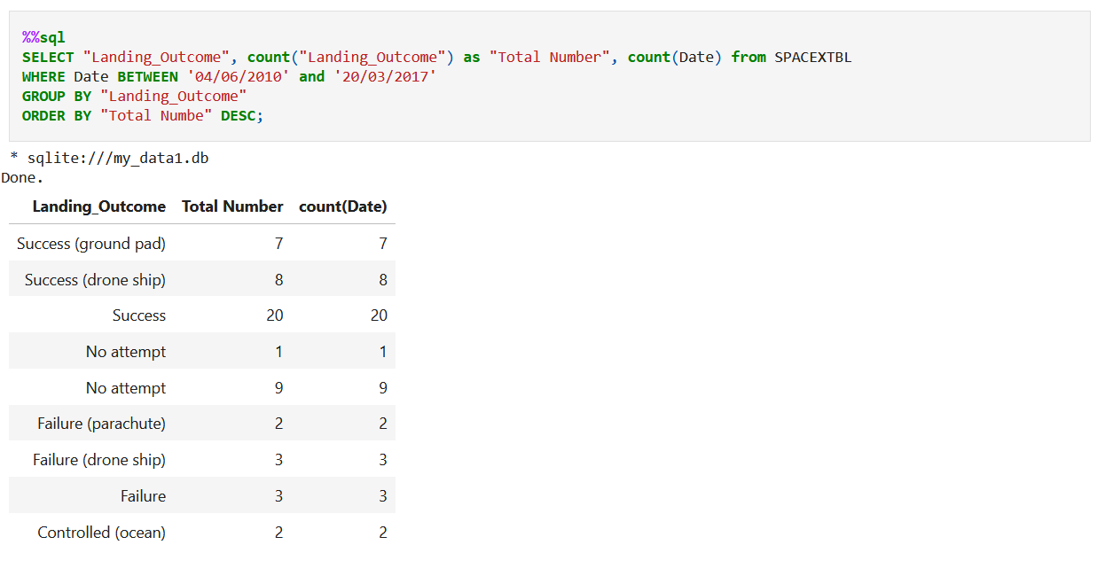
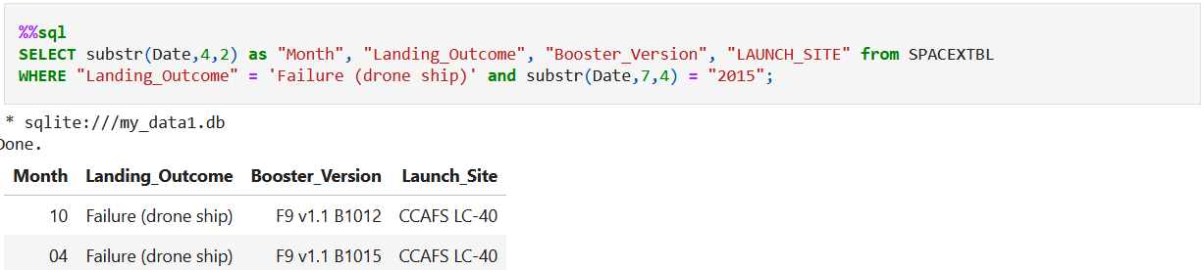
EDA with SQL

Slide 12
Build an Interactive Map with Folium
Launch Sites Location Analysis ~ Link to Jupyter Notebook on GitHub
Used Python interactive mapping library called Folium
Marked all launch sites on a map
Marked the successful/failed launches for each site on map
Calculated the distances between a launch site to its proximities
Railways
Highways
Coastlines
Cities

Slide 13
Build a Dashboard with Plotly Dash
Launch Records Dashboard ~ Link to Dashboard Code on GitHub
Used Python interactive dashboarding library called Plotly Dash to enable stakeholders to explore and manipulate data in an interactive and real-time way
Pie chart showing success rate
Color coded by launch site
Scatter chart showing payload mass vs. landing outcome
Color coded by booster version
With range slider for limiting payload amount
Drop-down menu to choose between all sites and individual launch sites

Slide 14
Predictive Analysis (Classification)
Imported libraries and defined function to create confusion matrix
Pandas
Numpy
Matplotlib
Seaborn
Sklearn
Loaded the dataframe created during data collection
Created a column for our training label 'Class' created during data wrangling
Standardized the data
Split the data into training data and test data
Fit the training data to various model types
Logistic Regression
Support Vector Machine
Decision Tree Classifier
K Nearest Neighbors Classifier
Used a cross-validated grid-search over a variety of hyperparameters to select the best ones for each model
Enabled by Scikit-learn library function GridSearchCV
Evaluated accuracy of each model using test data to select the best model
Link to Jupyter Notebook on GitHub

Slide 15
Results
Biggest opportunities going forward to make even more informed bids:
Freeze the best performing combination of model and hyperparameters and re-fit using the whole dataset instead of just the training data
Potentially better than using only part of the data to fit the model, but you would no longer be able to measure the accuracy of the resulting model
Incorporate additional launch data to the dataset and model as it becomes available
Subdivide the current model into two models
Predict if SpaceX will ATTEMPT to land the 1st stage
Predict if SpaceX will SUCCEED in their attempt
Create a related model that predicts if SpaceX will launch using a previously-flown 1st stage booster
Would enable SpaceY to take into account when the SpaceX bid would likely include a discount

Slide 16

Section 2

Slide 17
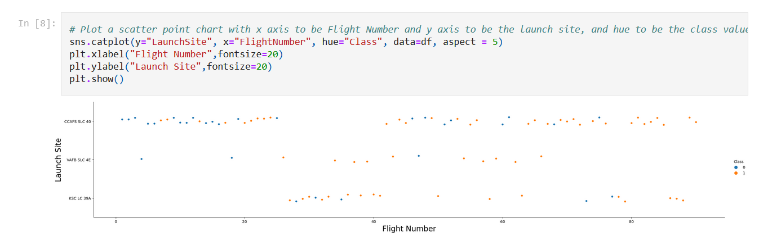
Flight Number vs. Launch Site

Slide 18
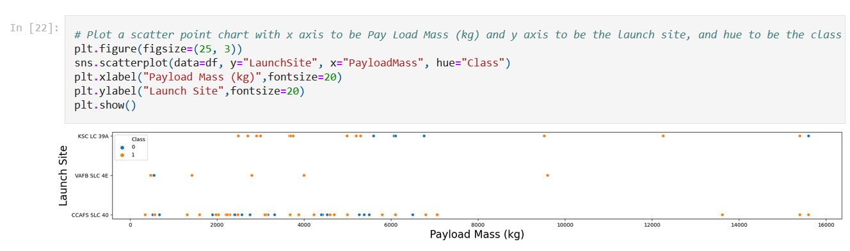
Payload vs. Launch Site

Slide 19
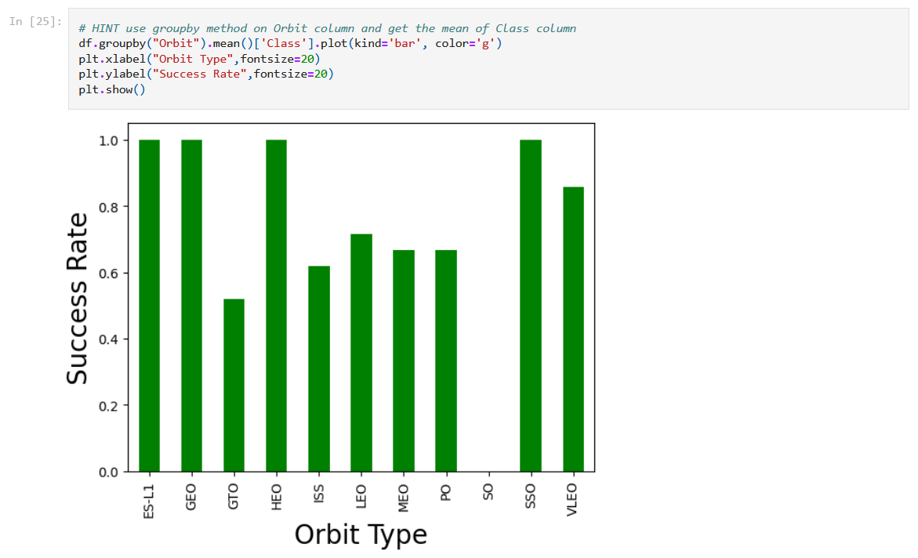
Success Rate vs. Orbit Type

Slide 20
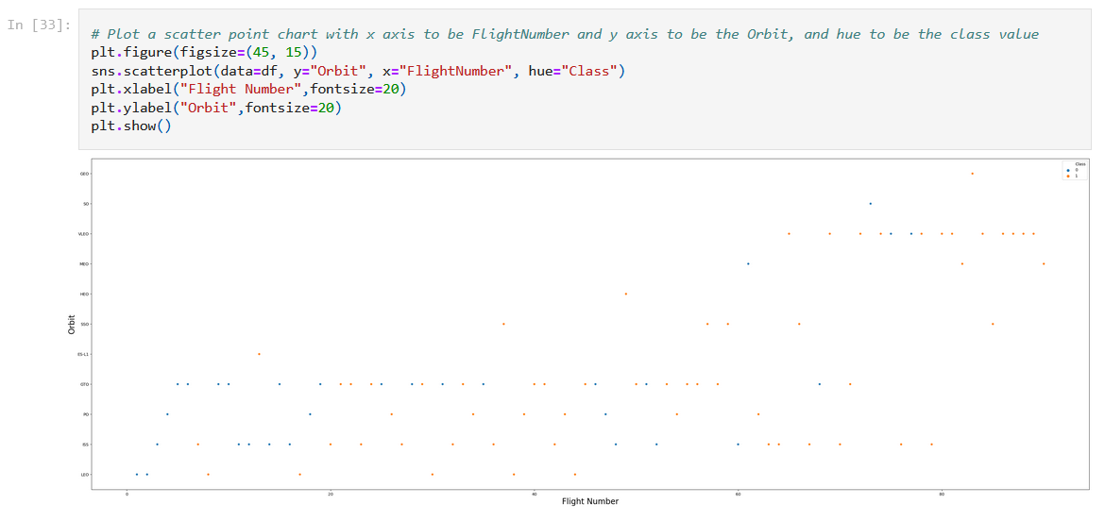
Flight Number vs. Orbit Type

Slide 21
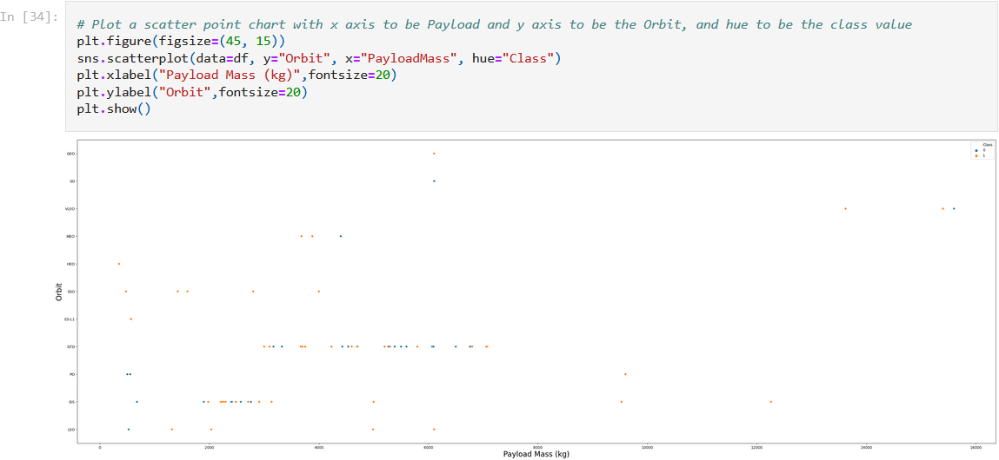
Payload vs. Orbit Type

Slide 22
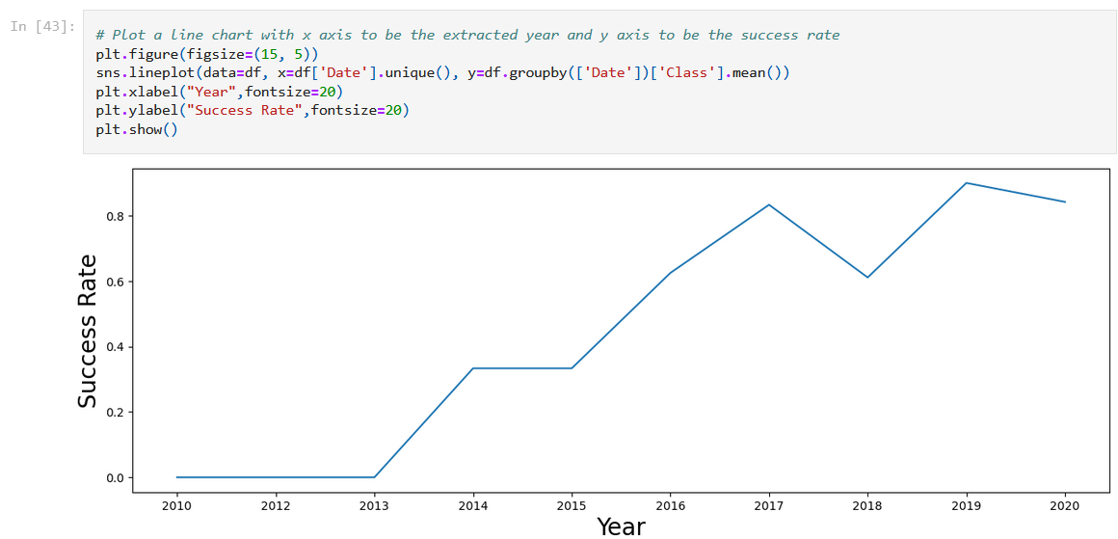
Launch Success Yearly Trend

Slide 23
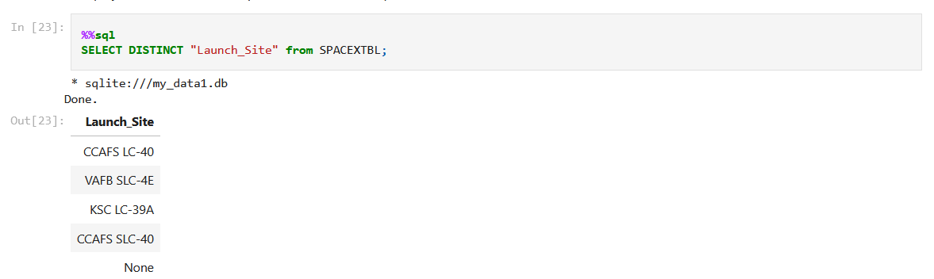
All Launch Site Names
There are four different launch sites through out USA and all the locations are coastal regions.

Slide 24
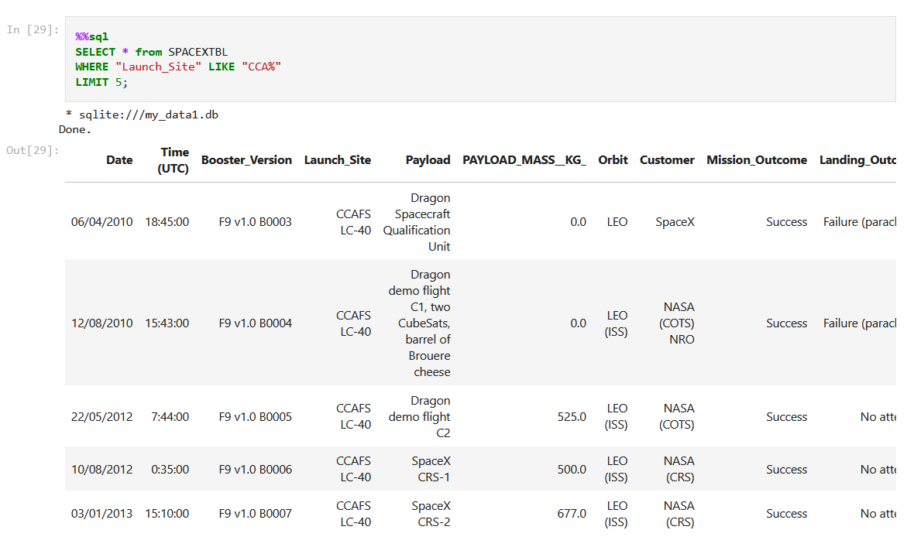
Launch Site Names Begin with 'CCA'
There are 60 records where launch sites name begin with the string 'CCA’.

Slide 25
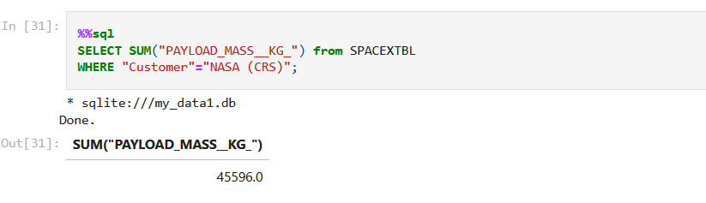
Total Payload Mass
The total payload mass carried by boosters launched by NASA (CRS) is 45,596 Kgs

Slide 26
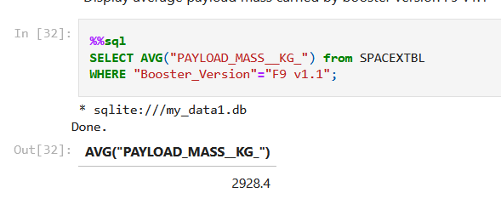
Average Payload Mass by F9 v1.1
The average payload mass carried by booster version F9 v1.1 is 2,928.4 Kgs

Slide 27
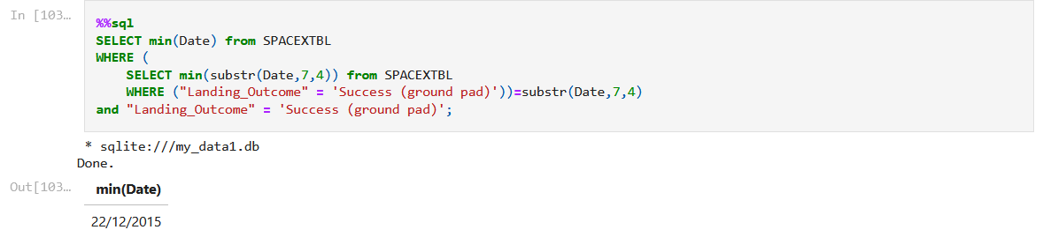
First Successful Ground Landing Date
22/12/2015 is the date when the first succesful landing outcome in ground pad was achieved.

Slide 28
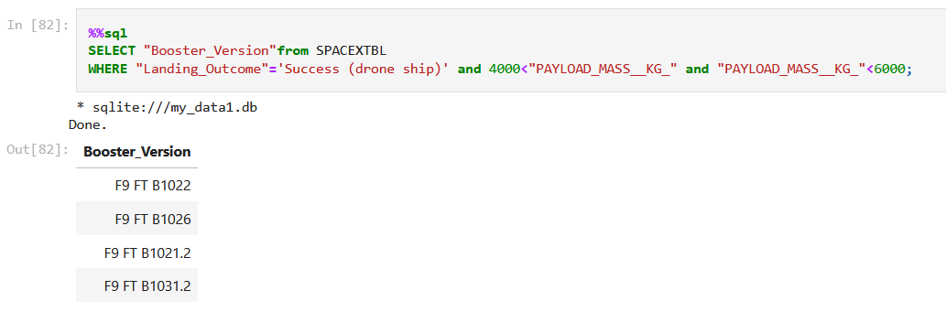
Successful Drone Ship Landing with Payload between 4000 and 6000
Five boosters has achieved success in drone ship and have payload mass greater than 4000 but less than 6000

Slide 29
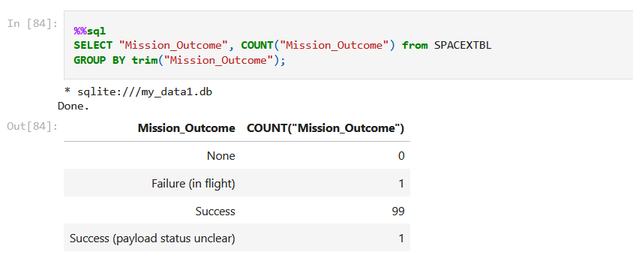
Total Number of Successful and Failure Mission Outcomes

Slide 30
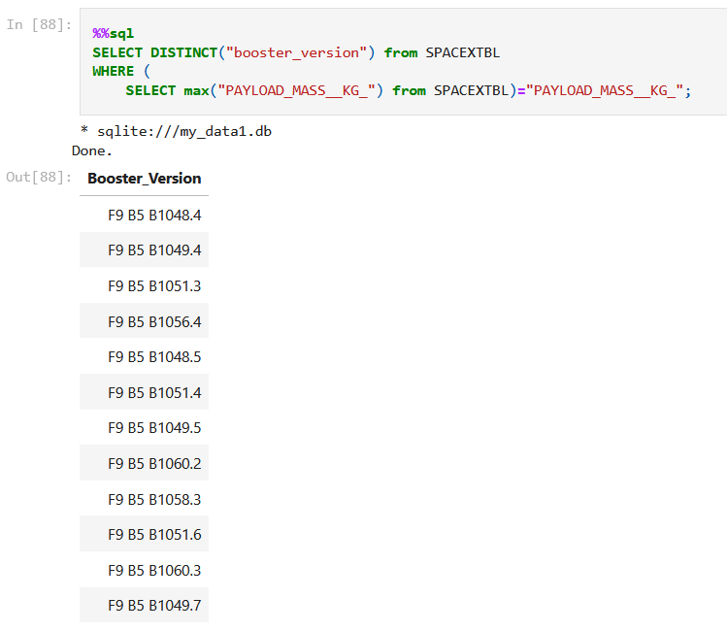
Boosters Carried Maximum Payload

Slide 31
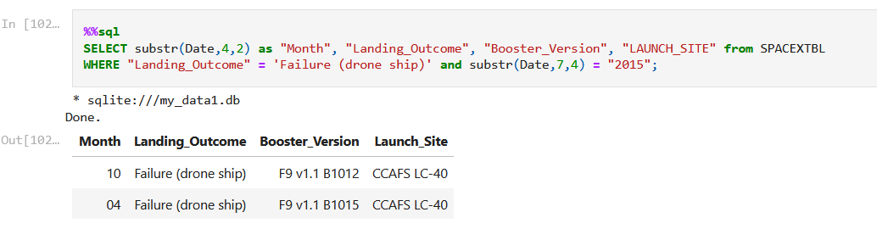
2015 Launch Records

Slide 32
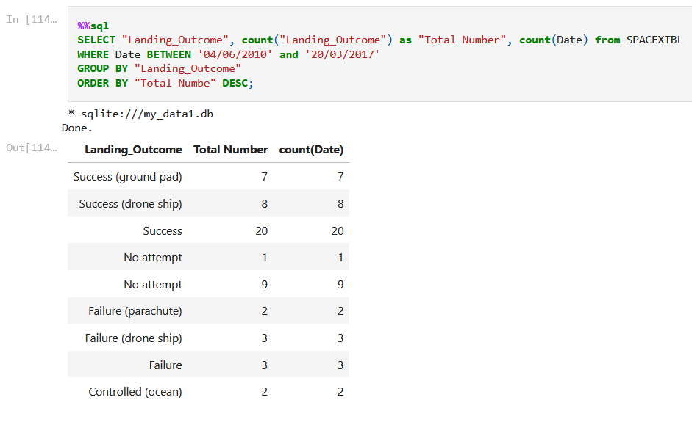
Rank Landing Outcomes Between 2010-06-04 and 2017-03-20

Slide 33

Section 3

Slide 34
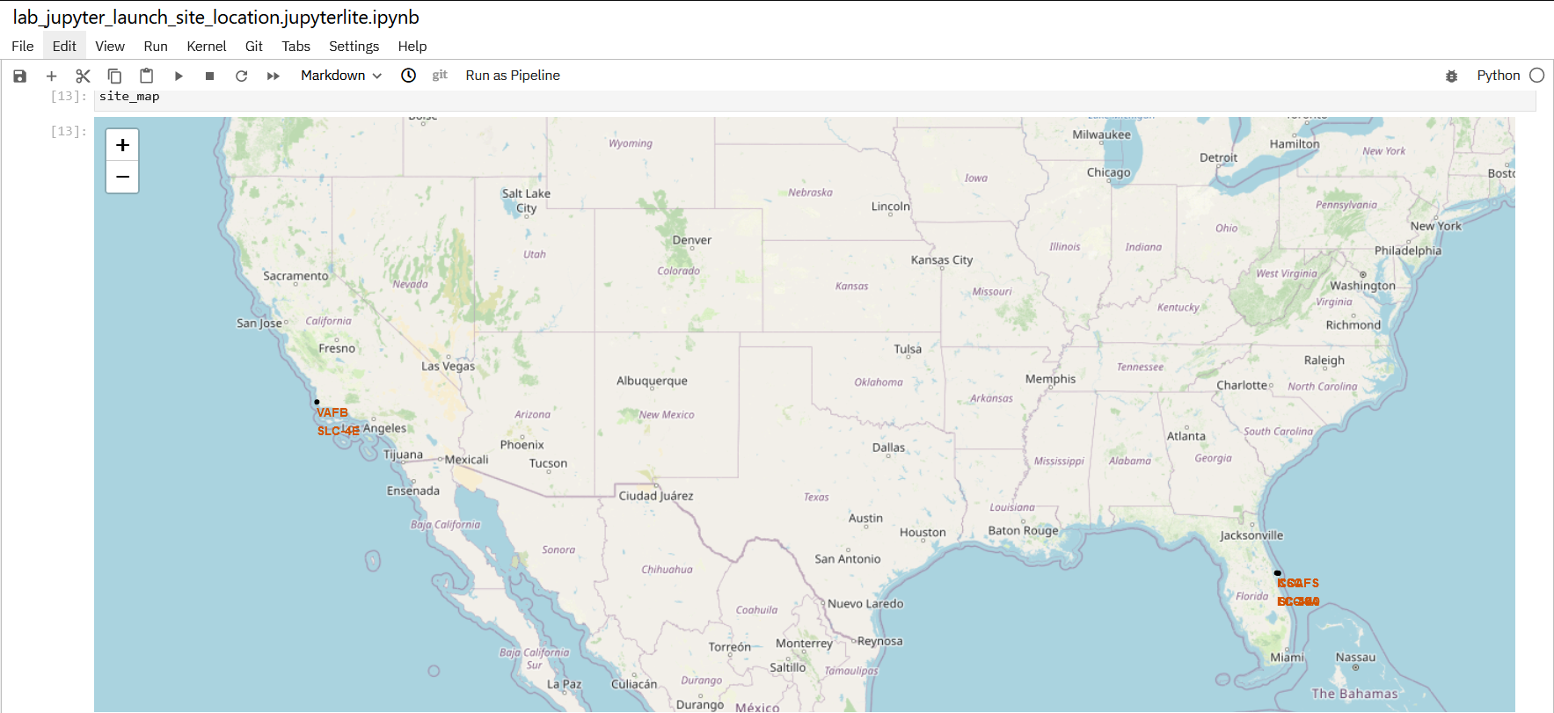
<Folium Map Screenshot 1>
Replace <Folium map screenshot 1> title with an appropriate title
Explore the generated folium map and make a proper screenshot to include all launch sites’ location markers on a global map
Explain the important elements and findings on the screenshot

Slide 35
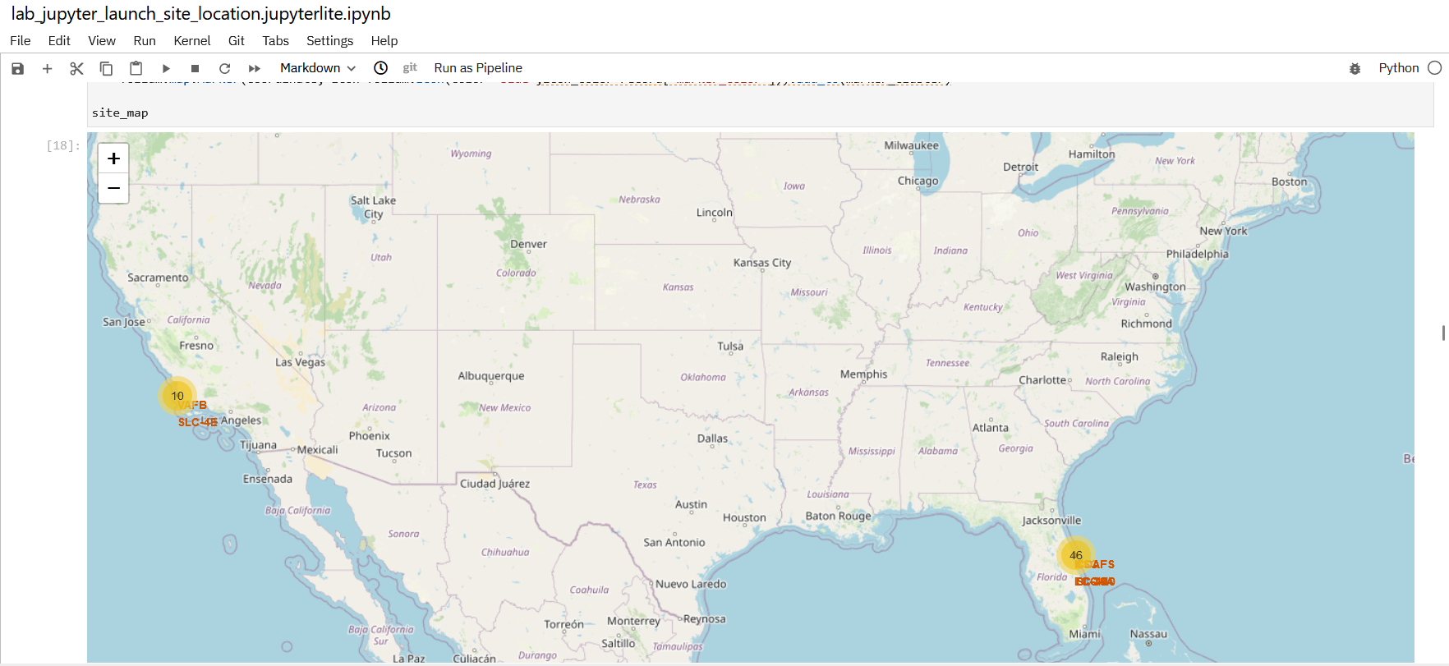
<Folium Map Screenshot 2>
Replace <Folium map screenshot 2> title with an appropriate title
Explore the folium map and make a proper screenshot to show the color-labeled launch outcomes on the map
Explain the important elements and findings on the screenshot

Slide 36
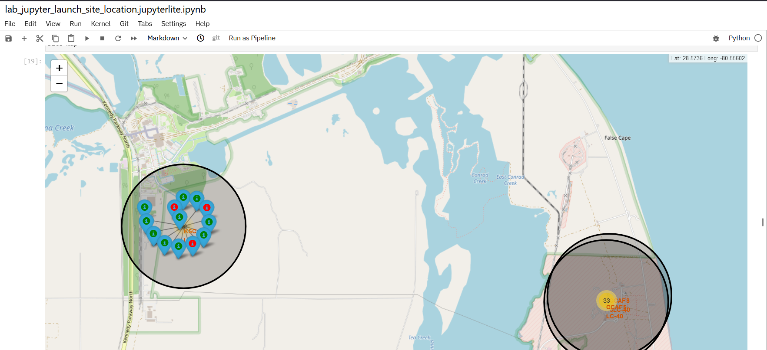
<Folium Map Screenshot 3>
Replace <Folium map screenshot 3> title with an appropriate title
Explore the generated folium map and show the screenshot of a selected launch site to its proximities such as railway, highway, coastline, with distance calculated and displayed
Explain the important elements and findings on the screenshot

Slide 37

Section 4

Slide 38
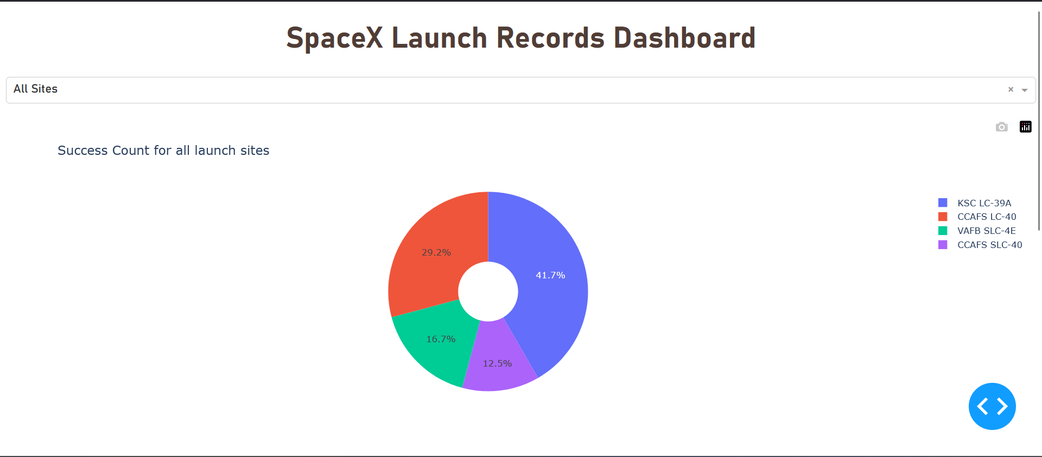
Dashboard: Pie Chart for all sites count of success launch

Slide 39
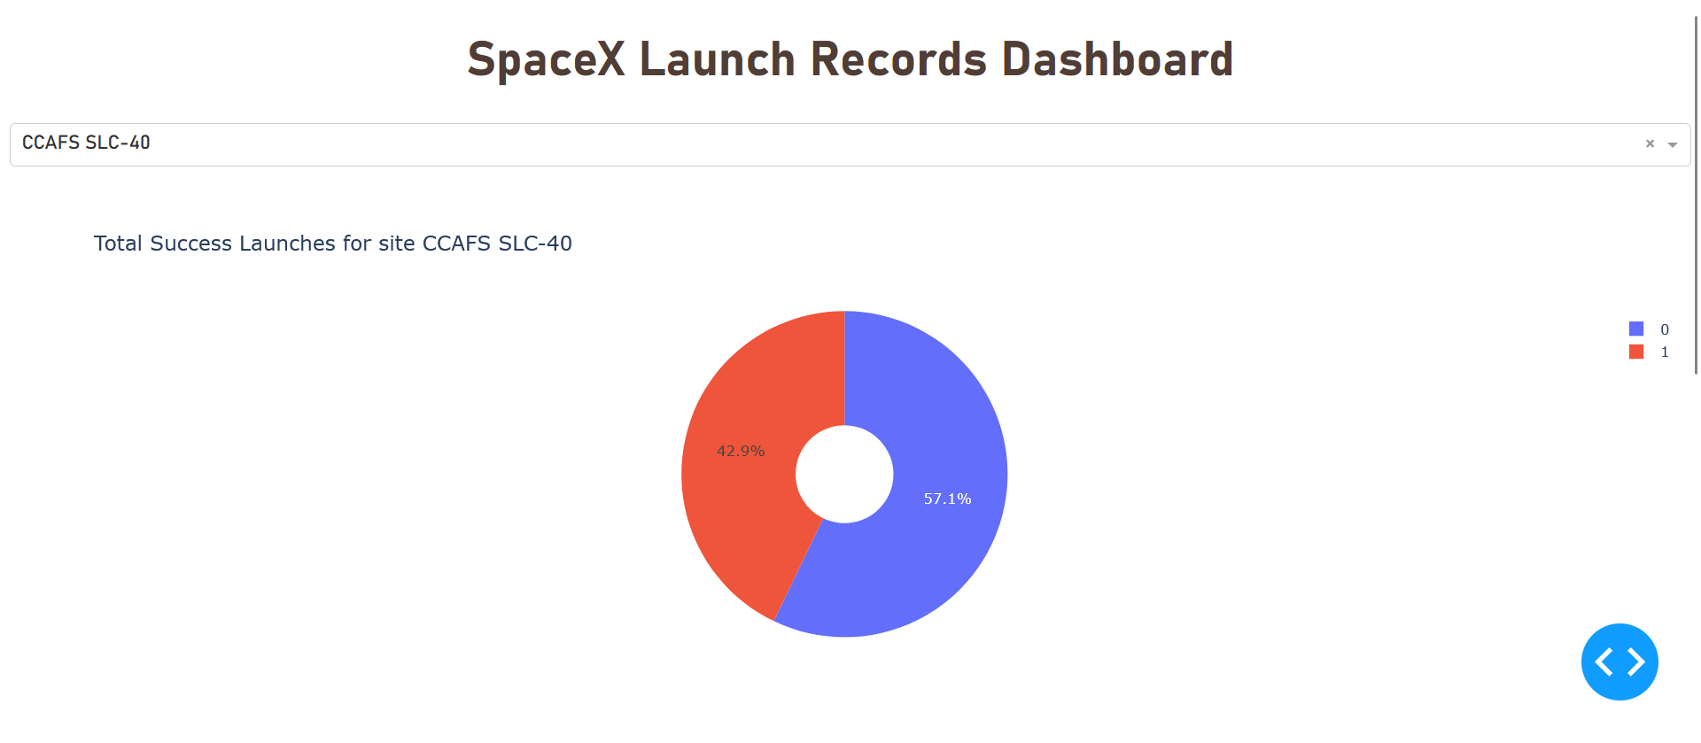
Dashboard: Pie Chart for CCAFS SLC-40 site launch count

Slide 40
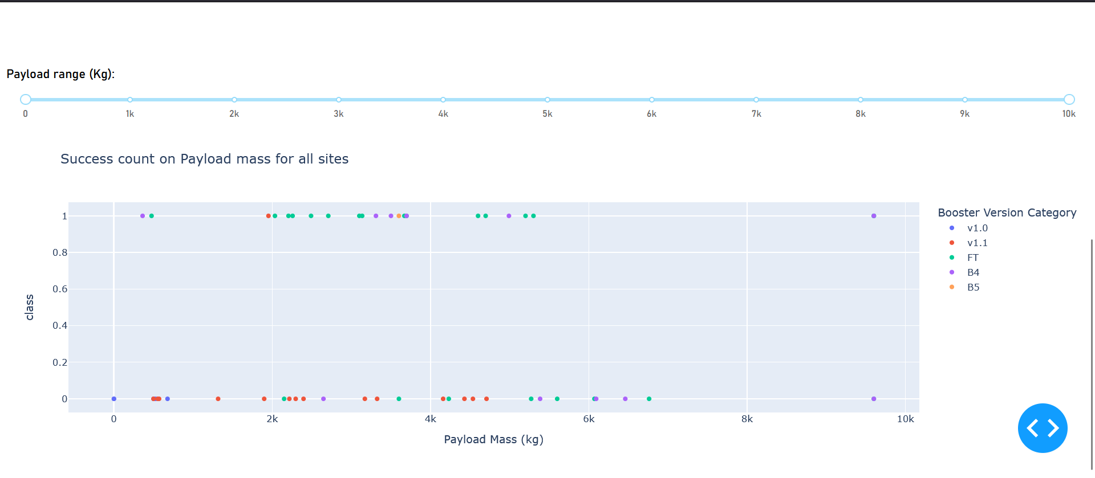
Dashboard: Scatter Pot of Payload vs Mass for all launch sites

Slide 41

Section 5

Slide 42
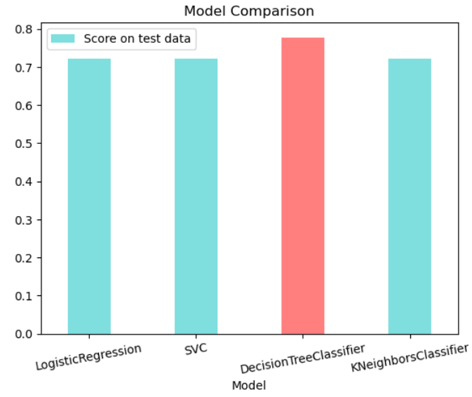
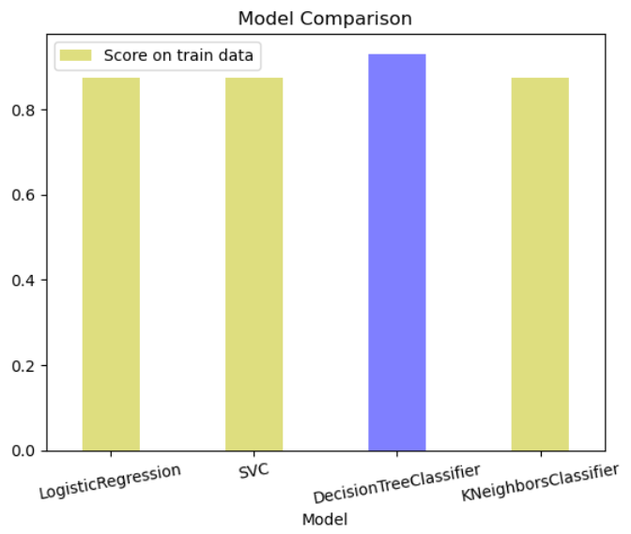
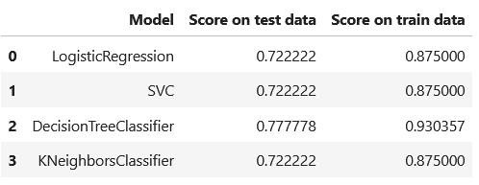
Classification Accuracy
We can see that the Decision Tree Classifier performs the best with an accuracy score of 77% and 93% approx. on test and train data respectively.

Slide 43
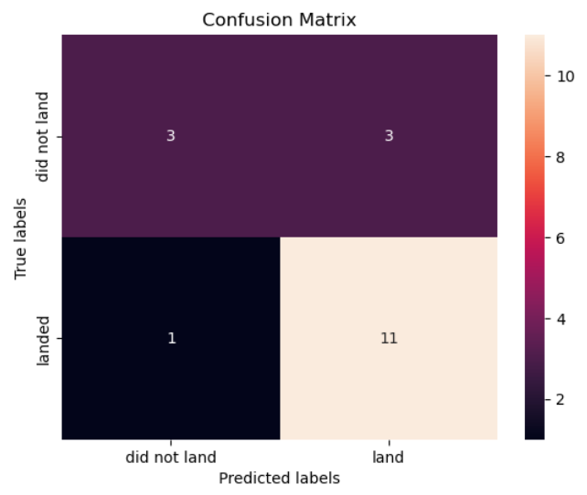
Confusion Matrix
Our model predicts essentially well with true-negative values, i.e., our model correctly predicted the landing, while the prediction for not landing is quite not accurate.

Slide 44
Conclusions
Using the models from this report, SpaceY can predict when SpaceX will successfully land the 1st stage booster with 83.3% accuracy
SpaceX public statements indicate the 1st stage booster costs upwards of $15 million to build
This will enable SpaceY to make more informed bids against SpaceX, since they will have a good idea when to expect the SpaceX bid to include the cost of a sacrificed 1st stage booster
With a list price of $62 million per launch, sacrificing the $15+ million 1st stage, would put the SpaceX bid at upwards of $77 million
Biggest opportunities going forward to make even more informed bids:
Freeze the best performing combination of model and hyperparameters and re-fit using the whole dataset instead of just the training data
Potentially better than using only part of the data to fit the model, but you would no longer be able to measure the accuracy of the resulting model
Incorporate additional launch data to the dataset and model as it becomes available
Subdivide the current model into two models
Predict if SpaceX will ATTEMPT to land the 1st stage
Predict if SpaceX will SUCCEED in their attempt
Create a related model that predicts if SpaceX will launch using a previously-flown 1st stage booster
Would enable SpaceY to take into account when the SpaceX bid would likely include a discount

Slide 45
Appendix & Acknowledgments
Thank you to Joseph Santarcangelo and Yan Lao at IBM for creating the course and materials
The code and necessary files used for this project can be found in the following GitHub repo: [Link to repo]
•References
https://aviationweek.com/defense-space/space/podcast-interview-spacexs-elon-musk
Interview with Elon Musk where he discloses the 1st stage booster to cost upwards of $15 million
https://datascience.stackexchange.com/a/33050
Explanation of why you would rebuild your model using the full dataset
https://www.spacex.com/vehicles/falcon-9/
Source of SpaceX's advertised $62 million launch price

Slide 46


